Slide 1
A Survey of
Deep Learning-Based Source
Image Forensics
Introduction
Source Camera Identification

Slide 2


Introduction
Source Camera Identification
2.1 Traditional Convolutional Neural Networks(T.CNN)
2.2 Data Enhancement (D.E.)
2.3 Fusion and Ensemble (F./E.)
2.4 Patch Selection (P.S.)
2.5 Classifier (C.)

Slide 3

01
Introduction

Slide 4
01
Introduction
Purpose
With the advent of techniques based on artificial intelligence(AI) that can be exploited by malicious actors to spread “fake news”
Past
Pattern recognition
Statistical analysis
Recently
Deep learning-based schemes
In order to verify the authenticity and integrity of a digital image, a number of techniques, known collectively as “digital image forensics”

Slide 5
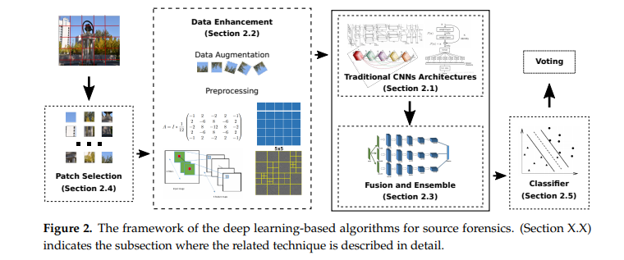
01
Introduction
Preprocessing by a spatial filter to improve their signal-to-noise(SNR)
Classifier result for the original image can be obtained by voting among the pixel patches
Cropped into small and fixed-size pixel patches
Patches are processed
Choose the patches by selection strategy
By having a softmax layer at the end of the network
By training a separate classifier on the features extracted by the last layer of the CNN

Slide 6
02
Source Camera Identification
2.1 Traditional Convolutional Neural Networks(T.CNN)
2.2 Data Enhancement (D.E.)
2.3 Fusion and Ensemble (F./E.)
2.4 Patch Selection (P.S.)
2.5 Classifier (C.)

Slide 7
02
Source Camera Identification
2.1 Traditional Convolutional Neural Networks(T.CNN)
Purpose : which is to trace where an image is from
Bondi[23]
Deep learning based schemes Source camera identification Firstly introduced by Bondi
Path-breaking method used a simple architecture with five layers including three conv layers, two FC layers
On full resolution image
Freire-Obregon[24]
Proposed six layer CNN, including two conv layers, one max pooling layer, three fully connected layers
Used in L-ReLU, led to slightly better performance than ReLU

Slide 8
02
Source Camera Identification
2.1 Traditional Convolutional Neural Networks(T.CNN)
Huang[25]
Presented an architecture similar to the on proposed by Bondi
Improve over the accuracy obtained by Freire-Obregon
Using Batch Normalization and more conv layers
Yao[26]
Put forward a 13 layers CNN
Robust against JPEG compression and noise adding
Not resistant to re-scaling operation
Chen[26]
Using ResNet with 26 layers
Accuracy 99.12%(brand-), 94.73%(model-), 45.81%(devide-level)

Slide 9
02
Source Camera Identification
2.1 Traditional Convolutional Neural Networks(T.CNN)
Ding[28]
Combining ResNet with multi-task learning strategy
Three task(brand-level, model-level, sensor-level) are integrated into one framework
Multi task learning
Marra[28]
Used XceptionNet, voting strategy

Slide 10
02
Source Camera Identification
2.1 Traditional Convolutional Neural Networks(T.CNN)
Realistic case is the open-set scenario, where information about query image is not completely known
A number of deep learning methods for this more challenging scenario have been proposed.
Bayar and Stamm[34]
Aims to judge whether the device that captured the query image is known or unknown
Uses a confidence score mapping with a thresholding strategy to evaluate whether the true source camera model is known or unknown
Uses different classifier on features extracted by a CNN
Mayer and Stamm[35]
Features are extracted form the last layer of a CNN and fed into a Siamese network to learn a measurement of source similarity
Verifying if two query images are captured by same device or not.
Source Camera Identification tasks closely follow the one of architectures proposed for computer vision tasks

Slide 11
02
Source Camera Identification
2.2 Data Enhancement (D.E.)
Including data augmentation and pre-processing → way to improve the performance
Bondi[36,37]
Normalized the images by subtracting the pixel-wise mean value
Kamal[31]
Random crops, random rotations, image manipulations(JPEG compression, gamma correlation, and resizing), image addition, empirical mode decomposition
Result
Adding more images has a great impact to performance
Using manipulated images enhances the robustness of the CNN model

Slide 12


02
Source Camera Identification
2.2 Data Enhancement (D.E.)
Computer vision task are seriously dependent on the image contents
Whereas the opposite is true when dealing with source camera identification
The correct class to be attributed to an example is heavily dependent on the noise component introduced by camera acquisition
To reduce the interference of the image contents
G: spatial filter F: denoising filter I : input N: noise
Tuama
chose wavelet-based denoiser (have been widely used in model-based schemes based on PRNU
HP filters yield better results than wavelet-based denoiser when used in CNN-based scheme
Bayar and Stamm
evaluated the effect of median filter(3x3)
Ding
Evaluated the case of gaussian filter residuals and verified their effectiveness

Slide 13
02
Source Camera Identification
2.2 Data Enhancement (D.E.)
Yang
Presented self-learning filters as a way to further improve the SNR
Bayar and Stamm
Proposed a novel constrained convolution which ensures that learned high-pass filters are within a given bound
Wang
Instead of designing the filter, used LBP to code the image
Image → LBP coding operation
Fed into CNN
self-learning filters, constrained convolutions, and LBP coding → outperform HP filters
Zuo
Indicate that the CNN model without pre-procession provides better performances
Most DE technique aims to reduce the influence of image contents by filtering out information deemed not useful

Slide 14
02
Source Camera Identification
2.3 Fusion and Ensemble (F./E.)
Fusion and Ensemble Aim to enhance performance by fusing multiple models and features together
Yang[42]
Merging three models → increasing accuracy
Bayar and Stamm[38]
Combined constrained convolutions and MFR at the first layer of CNN → slightly increasing
Kamal[31]
Ensemble feature of DenseNet201 trained using three image scales (64x64, 128x128, 256x256) → beneficial
Ferreira[33]
Integrate InceptionNet and XceptionNet → boost increase

Slide 15
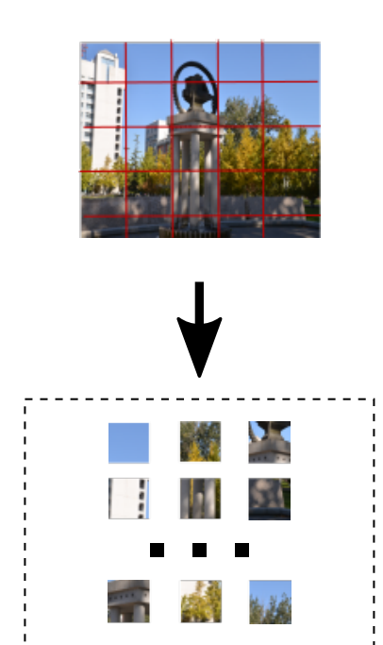
02
Source Camera Identification
2.4 Patch Select (P.S.)
A good strategy for choosing the best pixel patches to be used for CNN training can be essential to obtain higher performance
Bondi[37] , Kamal[31]
only select for training the pixel patches whose average values are close to half of the image dynamic range.
Pixel patches with higher measure value are used to train the CNN model
Guera[46]
proposed a CNN-based solution to estimate
Yang[43]
Pixel patches were separated into three subsets according to their mean and Variance
Different CNN model would be trained on each subset
Query pixel patches would be classified using the model corresponding to their characteristics.
dynamic range of a patch is considered to be the best descriptor for its usefulness for the task at hand.

Slide 16
02
Source Camera Identification
2.5 Classifier (C.)
Some image forensics researchers have recently explored if the adoption of different classifiers can improve the performance
Classifiers can achieve better performance with respect to simple softmax layers
SVM, ERT, cosine similarity measure, nearest mean score, squeeze and excitation block

